Slide 1

EARLY MISINFORMATION DETECTION BASED ON LINGUISTIC ANALYSIS
Abiodun Olukosi
12757680

Slide 2
Content Layout
Overview
Broad Subject Area
Narrow Subject Area
Relevant Existing Studies
Methodology
Conclusion
Future Works
References

Slide 3
Overview
Despite the significant progress made in detecting misinformation, significant challenges remain to be addressed. One of the main challenges is the ability to detect misinformation early. Most existing methods of detecting misinformation are reactive and need help to keep up with the rapid pace of information dissemination on digital platforms.
Various studies have recently developed automated strategies for detecting and combating misinformation by employing cutting-edge technologies like Natural Language Processing (NLP) and Machine Learning (ML).
These strategies are developed to analyse linguistic features, such as lexical, syntax, sentiment, and readability and exaggerated claims indicative of false information (Sousa-Silva, 2022).
Studies have shown that misinformation tends to portray certain linguistic patterns that can be distinguishable from genuine information (Mahyoob et al., 2020), as they utilise more emotive language, have a higher degree of vagueness, and use more exaggerated expressions.
Notes:
Once information is falsified by intent or by default, it is defined by Pennycook and Rand (2021) as Misinformation. Despite the significant progress made in detecting misinformation, significant challenges remain to be addressed. One of the main challenges with misinformation detection is the ability to detect misinformation early. Most existing methods of detecting misinformation are reactive and need help to keep up with the rapid pace of information dissemination on digital platforms. Additionally, the development of deep fake technology and other forms of advanced disinformation poses a significant challenge to detecting misinformation. NLP techniques are widely used in language translation, text classification, and sentiment analysis applications. Still, they find a more increased application in misinformation detection. One key advantage of NLP techniques, as opined by Faldu and Sheth (2020), is that they can capture a wide range of linguistic features, including word choice, syntax, and discourse structure, which upon analysis, identifies patterns indicative of deception and misinformation.

Slide 4
Broad Subject Area:
Natural Language Processing & Artificial Intelligence
This study falls within the broad subjects of Natural Language Processing (NLP) and Artificial Intelligence (AI).
Natural Language Processing (NLP) focuses on how computers can process and understand natural (human) languages. At the same time, Artificial Intelligence (AI) deals with developing algorithms and systems that can perform tasks that typically require human intelligence, such as perception, learning and reasoning.
Artificial intelligence research in natural language processing (NLP) aims to render a possibility for programs and robotics to comprehend, analyse, and produce human language.
In recent years, Natural Language Processing (NLP) techniques have emerged as a powerful tool for detecting and combating misinformation, offering a range of approaches that enable researchers to identify and analyse the linguistic patterns associated with deceptive texts.

Slide 5
Narrow Subject Area:
Early Misinformation Detection using Linguistic Analysis
The development of deep fake technology and other forms of advanced disinformation poses a significant challenge to detecting misinformation. The societal concern over and global risk associated with information distortion and manipulation persists.
Linguistic analysis has been proposed as a potential solution to detect and combat misinformation. By analysing grammar, syntax, and vocabulary to identify patterns that can be used to detect misleading information (Rubin et al., 2015).
The significance of linguistic analysis in detecting and combating misinformation lies in its ability to identify subtle linguistic cues that indicate false information (Wang et al., 2018).
Detecting misinformation is a complex task, and traditional approaches often need to be revised to capture the intricacies of language use in deceptive texts. Lexical, semantic, and syntactic features have independently been employed in detecting misinformation, and nascent research has proposed combining these features to enhance detection accuracy.

Slide 6
Research Queries
In this study, the central research problem revolves around detecting misinformation, a pressing issue in today's age of digital media. To tackle this problem, the following research questions will be addressed:
What distinguishing linguistic and psychological features set misinformation apart from accurate information?
How can machine learning algorithms be trained to identify misinformation based on these linguistic and psychological features?
What methods can be employed to improve the detection of sophisticated forms of disinformation, such as deep fakes?

Slide 7
Aim & Objectives
This study aims to exploit Feature-based classifiers and linguistic patterns in ascertaining a reliable misinformation detection technique that will also be evaluated against other pertinent published studies.
To answer the research queries, the following objectives guide this research:
Utilize the linguistic and psycholinguistic properties of the retrieved LIAR dataset to conduct a thorough assessment of prior publications on the subject of detecting false news.
Develop machine learning algorithms such as Random Forest, Light GBM, Catboost and Naïve Bayes based on textual features (linguistics and psycholinguistic features) to classify or ascertain the degree of veracity or falsity of the datasets based on linguistic analysis
Investigate the effectiveness of the proposed approach in detecting advanced forms of disinformation, such as deep fakes.

Slide 8
Review of Existing Literature
Author(s) | Title | Research Question | Methodology | Key Findings
Khanam et al. (2021) | Fake News Detection Using Machine Learning Approaches | Can a model be created using supervised machine learning algorithms to detect and classify fake news articles as true or false? | The approach utilised feature extraction to gather and preprocess a manually annotated dataset. Naive Bayes and Random Forest were two supervised machine learning techniques that were utilised to train and test the dataset. To achieve the best level of accuracy and precision, a variety of classification techniques, including k-Nearest Neighbors, Linear Regression, XGBoost, Naive Bayes, Decision Tree, Random Forests, and Support Vector Machine (SVM), were used both alone and in combination. | Text data was tokenised using the Python scikit-learn library, and features were extracted using the Count Vectorizer and Tfidf Vectorizer tools. By combining their averages, the classifiers could produce results that were as accurate as feasible. The resulting model had great accuracy in identifying and categorising bogus news stories.
Agarwala et al. (2019) | Analysis of Classifiers for Fake News Detection | Which machine learning classifiers work best for detecting fake news in text data, and how does the choice of feature selection method affect the performance of the classifiers? | The study employed feature selection techniques such bag-of-words, n-grams, and term frequency-inverse document frequency (TF-IDF) weighting after pre-processing the text data using tokenization, stemming, and lemmatization. Using the scikit-learn library, they examined and trained five machine learning classifiers (Naive Bayes, Logistic Regression, Linear SVM, Stochastic Gradient Classifier, and Random Forest Classifiers), comparing their performance using F1 scores, recall, and precision. | According to the authors, the most successful feature selection techniques for identifying fake news were TF-IDF weighting and n-grams. The top performers were the Linear SVM and Logistic Regression classifiers, with F1 scores of 0.88 and 0.87, respectively. They also discovered optimising the classifiers' performance with a confusion matrix and GridSearchCV techniques.

Slide 9
Misinformation Detection Methodology using a LIAR dataset
METHODOLOGY
Data Collection
Data Preprocessing
Model Selection & Training
Model Evaluation & Deployment
  The LIAR dataset is sourced from Kaggle.com and available in the form of .tsv files, which are read using the read_csv function of pandas library.
  Prepares the data for analysis by transforming raw data into a format suitable for machine learning algorithms.
  Using a Supervised Machine learning Approach, with Learning Algorithms such as Random Forest, Light Gbm, xgboost, and Catboost.
  The model’s performance is evaluated using the Accuracy-score evaluation metrics.
Notes:
Methodology
The methodology entails developing an early misinformation detection system using the LIAR dataset which involves several steps, including data preprocessing, feature extraction, model selection, model training, model evaluation, model tuning, and model deployment. The key to building an accurate and reliable system is carefully selecting the features, algorithm, and hyperparameters and evaluating the model's performance on a separate validation or test set.

Slide 10
Datasets
The approved datasets, including; training, testing, and validation datasets, used in this study were sourced from a LIAR-PLUS dataset updated by Chaturvedi, S. (2019) on Kaggle https://www.kaggle.com/datasets/saketchaturvedi/liarplus.
The PHEME dataset (Zubiaga et al., 2016) which contains a collection of rumors and non-rumors posted on Twitter during breaking news events.
Notes:
The dataset used for this study is a collection of news articles from PolitiFact, an American nonprofit organisation that fact-checks the statements made by politicians. The dataset is split into training, testing, and validation datasets, each in a tab-separated format. This study aims to extract syntactic/lexical, Unigram and Bigram features, sentiment-based and readability features from the dataset, which will be used as input for a machine learning algorithm to classify political statements.

Slide 11
LIAR DATASET ANALYSIS RESULTS

Slide 12
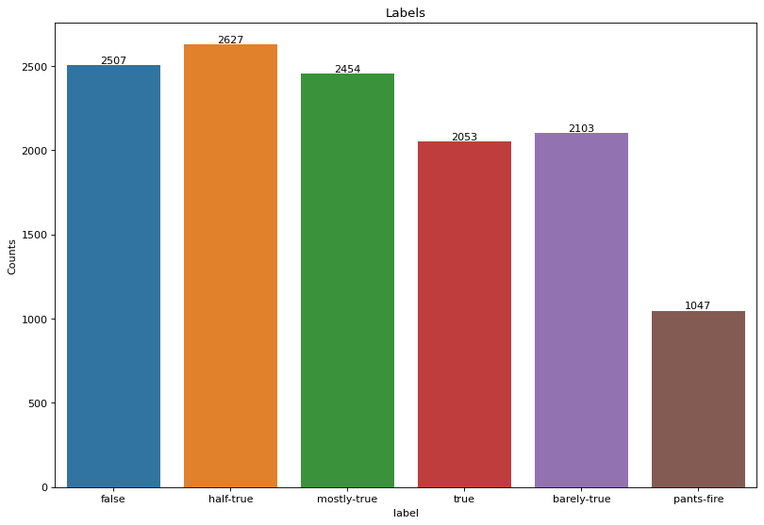
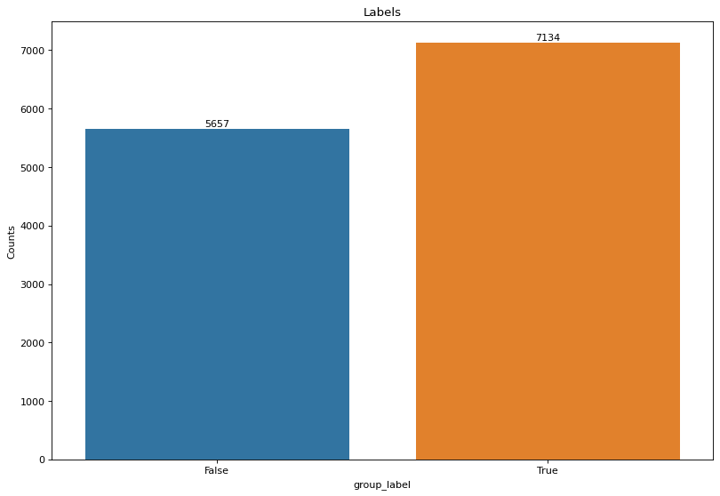
Label Distribution
The figure below shows the distribution of labels in the dataset, the graph shows that the dataset is balanced.
The label was turned to binary by labelling false, barely-true and pants-fire as False and the rest of the labels as True.
Ungrouped Labels
Grouped Labels
Notes:
The model was trained using the LightGBM and Random Forest algorithms and achieved high accuracy scores on the training dataset, with 93% and 99%, respectively. However, when the model was tested on the test dataset, the accuracy score dropped significantly to 42% and 40% for LGBM and Random Forest, respectively. This indicates that the model overfits the training data, meaning it performs well on the training data but needs to generalise optimally to newer datasets.

Slide 13
Features Extracted
Syntax based/Lexical Features e.g word count, average word length, POS count, punctuation count, stopwords count etc.
Sentiment based Features e.g Polarity Score, Subjectivity score, Emotion
Readability-based Features e.g Flesch-Kincaid Grade Level, Flesch Reading Ease Index, Gunning Fog Index, Automatic Readability Index (ARI), Coleman Liau Index
Notes:
The study extracted eleven (11) different syntactic and lexical features from the LIARPLUS dataset with features including character count, word count, sentence count, stopword count, uppercase count, average word length, average sentence length, punctuation counts, number count, and Part of speech (POS) tags. Sentiment based Features were extracted using sentiment analysis. The goal of sentiment analysis is to automatically identify the emotional tone of a text and determine whether the writer's attitude is positive, negative, or neutral. In this case, the text2emotion package was used in performing sentiment analysis on a dataset. Readability features such the Automated Readability Index, SMOG and Coleman Liau were also extracted.

Slide 14
RATIONALE BEHIND FEATURE EXTRACTION
•The extraction of syntax-based and lexical features is based on the assumption that language can reveal insights about the content of the text. The word count indicates the text's length and complexity, while the average word length indicates the level of vocabulary used. The count of parts of speech (POS) gives insight into the style and tone of the text, and the count of punctuation.
•Sentiment-based features, such as polarity and subjectivity scores, aim to capture the emotional content of the text, which is useful in sentiment analysis, where the goal is to determine whether the overall sentiment of the text is positive, negative, or neutral.
•Readability-based features aim to capture how easy or difficult the text is to read and understand. Automated Readability Index, SMOG index, Coleman Liau etc. are some of the common readability formulas used to calculate the readability of a text based on factors such as word length, sentence length, and the number of complex words used.

Slide 15
MODELS
The extracted features was trained using five algorithms:
LightGBM algorithm
Random Forest algorithm
Catboost
Naïve Bayes
Logistic Regression
Notes:
The data was trained using two algorithms:
LightGBM algorithm: This is a tree-based algorithm with a gradient-boosting framework. It is considered to be a fact-processing algorithm.
Random Forest algorithm: This ensemble algorithm works by combining multiple decision trees. They are known to help prevent overfitting.

Slide 16
Light GBM (Gradient Boosting Machine)
The rationale behind the LightGBM, is as opined by Zhang et al. (2019), to address the limitation of traditional decision tree algorithms by adopting a leaf-wise approach to construct decision trees, also known as the best-first approach.
Unlike the depth-first approach, LightGBM selects the leaf with the largest gradient at each level and grows the tree level by level. As a result, the algorithm only needs to examine a small fraction of the data to find the best split, leading to faster training times.

Slide 17
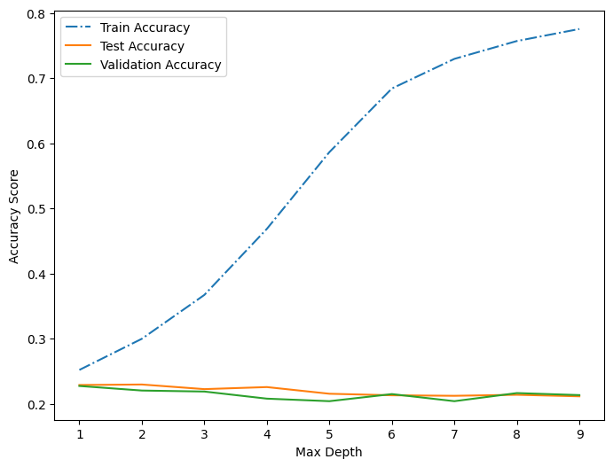
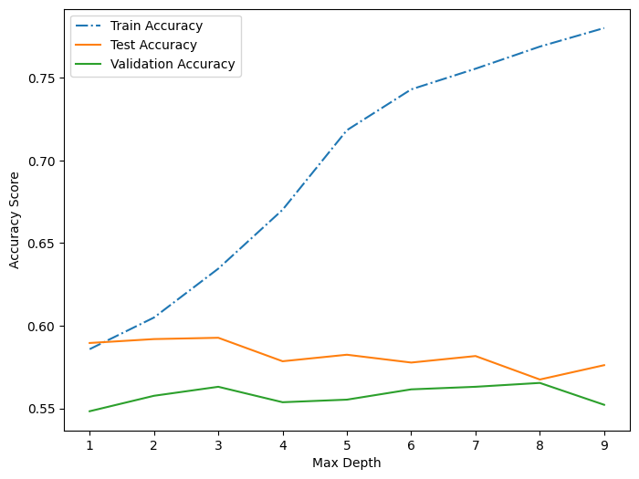
Light GBM Model
The graphs below shows the training and evaluation performance for light-gbm model for grouped and ungrouped label across a max depth range of 1 to 10
Ungrouped Labels
Grouped Labels
The graphs shows that the over-fitting level of the model increases as the max depth increases.
The graphs also shows that grouping the labels gave better performance compared with ungrouped labels.

Slide 18
RANDOM FOREST MODEL
The rationale behind using a Random Forest Model is its ability to handle high-dimensional and complex data sets while reducing the risk of overfitting (Breiman, 2001).
Unlike a single decision tree susceptible to overfitting, the Random Forest Model combines several decision trees, each trained on a subset of the data, and uses a majority vote to predict the output. Thereby increasing the likelihood of more accurate predictions and reducing the risk of overfitting.

Slide 19
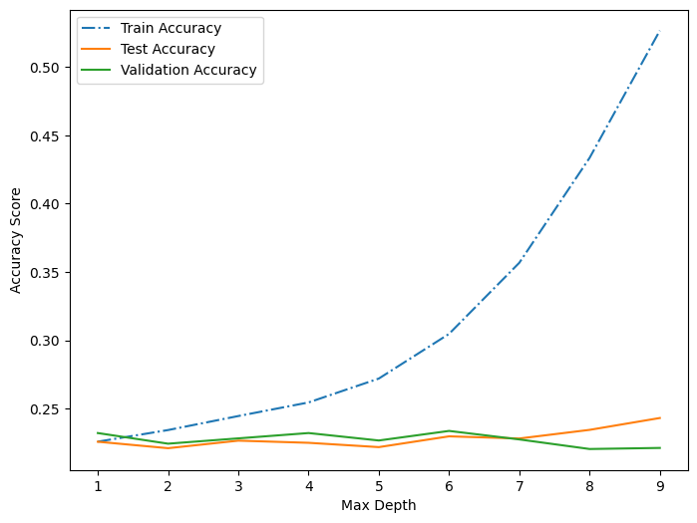
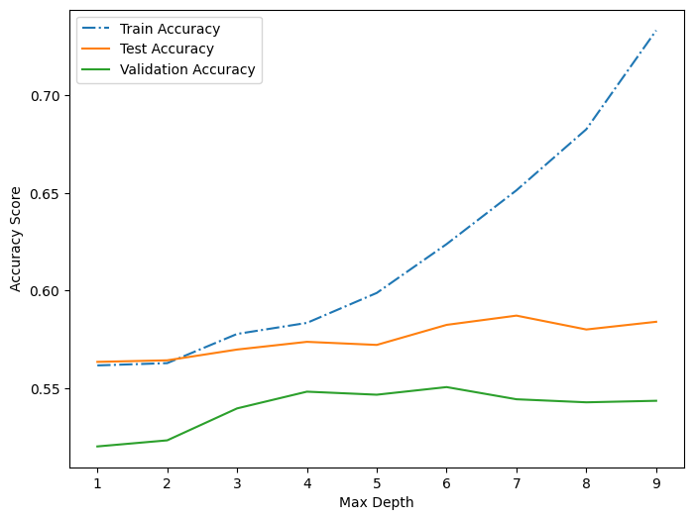
Random Forest Model
The graphs below shows the training and evaluation performance for random forest model for grouped and ungrouped label across a max depth range of 1 to 10
Ungrouped Labels
Grouped Labels
The graphs shows that the over-fitting level of the model increases as the max depth increases.
The graphs also shows that grouping the labels gave better performance compared with ungrouped labels.

Slide 20
CATBOOST MODEL
Traditional machine learning algorithms often struggle with categorical variables requiring preprocessing to convert them into numerical variables through a one-hot encoding process (Mishra, 2019), which according to Ibrahim et al. (2020), the Catboost model addresses this issue by using ordered boosting, optimised for categorical variables to minimise the loss function during training, allowing the model to learn from the categorical variables more effectively.

Slide 21
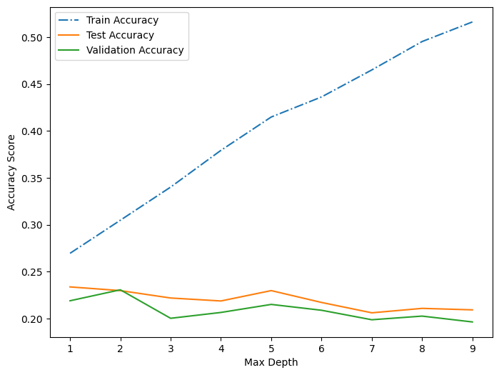
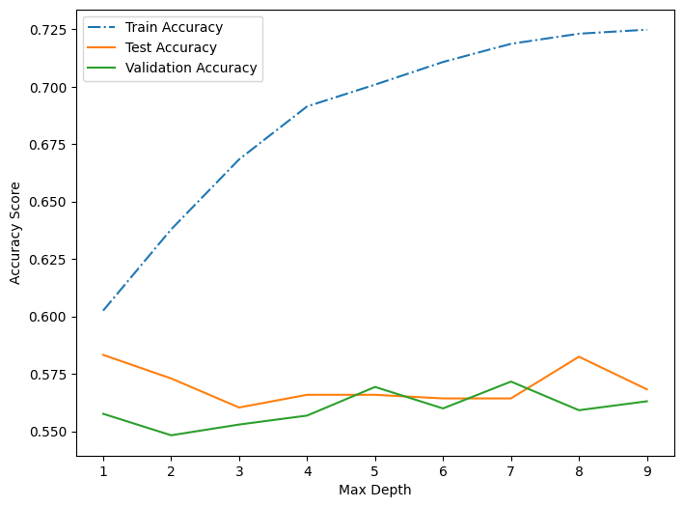
Catboost Model
The graphs below shows the training and evaluation performance for catboost model for grouped and ungrouped label across a max depth range of 1 to 10
Ungrouped Labels
Grouped Labels
The graphs shows that the over-fitting level of the model increases as the max depth increases.
The graphs also shows that grouping the labels gave better performance compared with ungrouped labels.

Slide 22
Naives Bayes & Logistic Regression
Naive Bayes and Logistic Regression models were used in text classification and sentiment analysis, predicting the probability of a document belonging to a particular class based on the frequency of words in the document.
While the Naive Bayes algorithm is based on the Bayes theorem with the premise that the features are independent, hence the term "naive", the Logistic Regression uses a logistic function in its prediction.

Slide 23
Naïve Bayes & Logistic Regression
The tables below show the Naive Bayes and Logistic Regression model results for ungrouped and grouped labels with the parameters set to default.
Naive Bayes | Ungrouped | Grouped
Train | 0.18 | 0.51
Test | 0.16 | 0.49
Validation | 0.18 | 0.51
Logistic Regression | Ungrouped | Grouped
Train | 0.24 | 0.58
Test | 0.22 | 0.57
Validation | 0.22 | 0.56
The result shows that both models do not overfit with the default parameters.
The result also shows that the grouped labels outperforms ungrouped labels

Slide 24
TF-IDF (Term Frequency-Inverse Document Frequency)
The rationale behind TF-IDF (Term Frequency-Inverse Document Frequency) is to compute two metrics for each word in a document for text classification. The term frequency (TF) and the inverse document frequency (IDF). The term frequency measures the frequency of occurrence of a word in a document, while the IDF measures the rarity of a word across all documents in a corpus.
To demonstrate the effectiveness of TF-IDF, studies by Liu et al. (2018) have shown that it outperforms simpler methods like bag-of-words in several tasks, including text classification and information retrieval.

Slide 25
TF-IDF
The Five algorithms, Logistic Regression, Catboost, Random Forest, Naïve Bayes and Light-GBM, were equally trained on the TF-IDF features.
The text was cleaned by removing the stop-words, digits, punctuations and white spaces before extracting features with TF-IDF

Slide 26
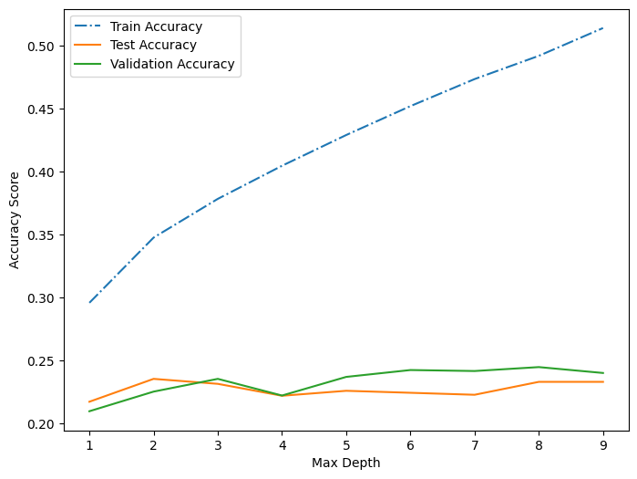
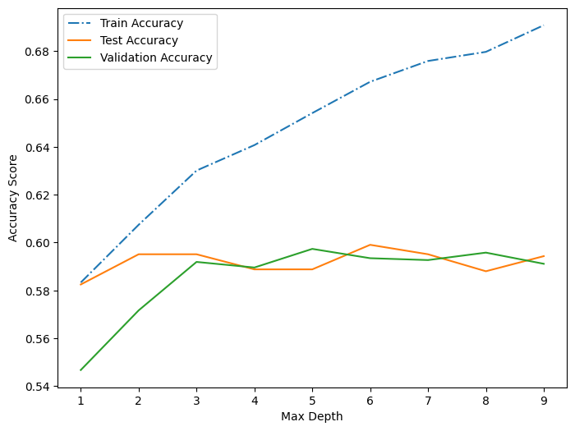
Light GBM Model
The graphs below shows the training and evaluation performance for light-gbm model for grouped and ungrouped label across a max depth range of 1 to 10
Ungrouped Labels
Grouped Labels
The graphs shows that the over-fitting level of the model increases as the max depth increases.
The graphs also shows that grouping the labels gave better performance compared with ungrouped labels.

Slide 27
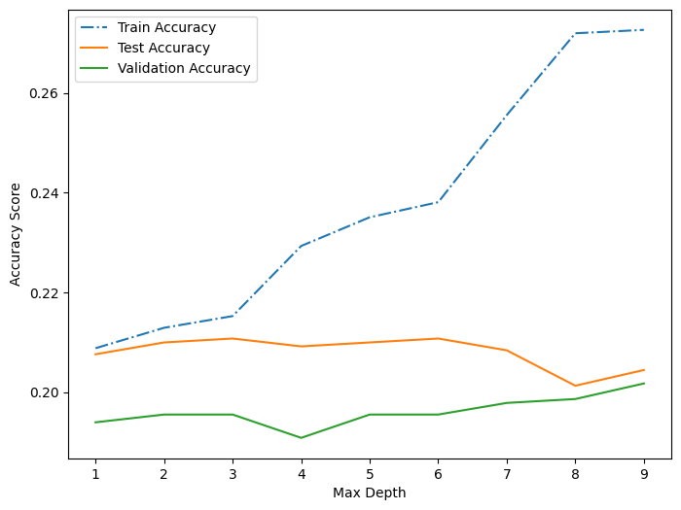
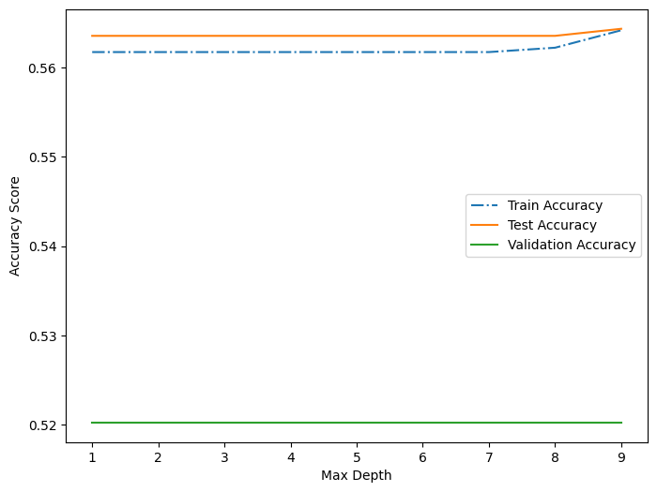
Random Forest Model
The graphs below shows the training and evaluation performance for random forest model for grouped and ungrouped label across a max depth range of 1 to 10
Ungrouped Labels
Grouped Labels
The graphs shows that using ungrouped labels, the over-fitting level of the model increases as the max depth
increases while with the grouped labels the model do not overfit even as max depth increases
The graphs also shows that grouping the labels gave better performance compared with ungrouped labels.

Slide 28
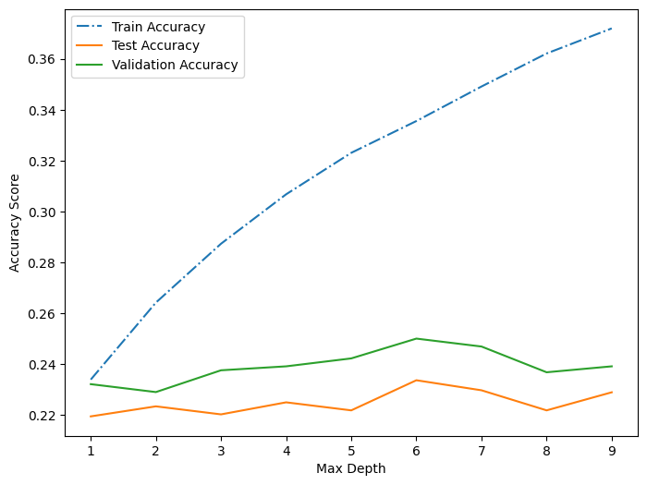
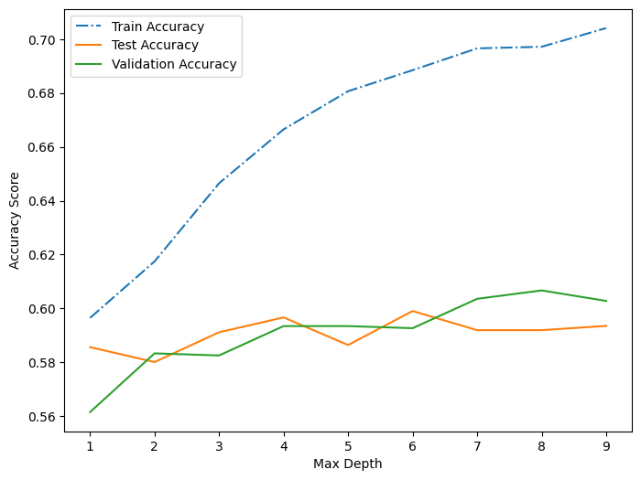
Catboost Model
The graphs below shows the training and evaluation performance for catboost model for grouped and ungrouped label across a max depth range of 1 to 10
Ungrouped Labels
Grouped Labels
The graphs shows that the over-fitting level of the model increases as the max depth increases.
The graphs also shows that grouping the labels gave better performance compared with ungrouped labels.

Slide 29
Naïve Bayes & Logistic Regression
The tables below show the Nave Bayes and Logistic Regression model results for ungrouped and grouped labels with the parameters set to default.
Naive Bayes | Ungrouped | Grouped
Train | 0.69 | 0.75
Test | 0.18 | 0.49
Validation | 0.20 | 0.51
Logistic Regression | Ungrouped | Grouped
Train | 0.68 | 0.79
Test | 0.25 | 0.61
Validation | 0.22 | 0.60
The result shows that both models overfit using the ungrouped labels but do not with the grouped models.
The result also shows that the grouped labels outperforms ungrouped labels

Slide 30
Bidirectional Long Short-Term Memory (LSTM)
Traditional LSTMs are Unidirectional such that contextual information from the end of the sequence may not be available to the network when making predictions about words at the beginning of the sequence.
Bidirectional LSTMs were introduced to address this issue by simultaneously processing the input sequence in both forward and backward directions. The forward LSTM processes the sequence from the beginning, while the backward LSTM processes the sequence from the end, enabling the network to capture past and future context about each word in the sequence, improving the accuracy of NLP models.

Slide 31
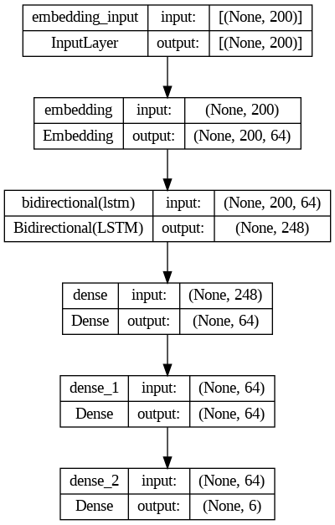
Bi-directional LSTM
The texts was cleaned by removing the stop-words, digits, punctuations and white spaces.
In this model architecture, the input sequence is processed in two directions: forward and backwards.
The forward LSTM processes the input sequence from the beginning to the end, while the backward LSTM processes the input sequence from the end to the beginning.
Model architecture

Slide 32
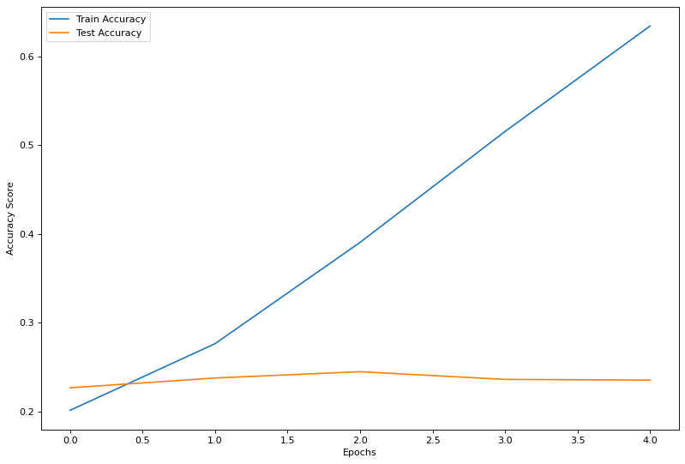
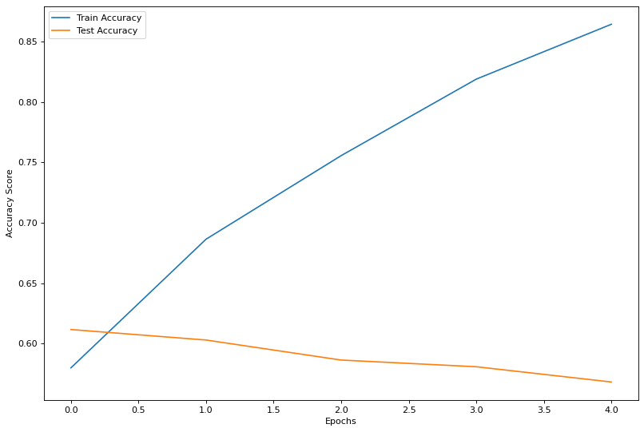
Result
The graphs below shows the training and evaluation performance for the deep learning model for grouped and ungrouped label across 5 training epochs
Ungrouped label
Grouped label
The graphs shows that the over-fitting level of the model increases through the epochs.
The graphs also shows that grouping the labels gave better performance compared with ungrouped labels.

Slide 33
PHEME DATASET ANALYSIS RESULTS

Slide 34
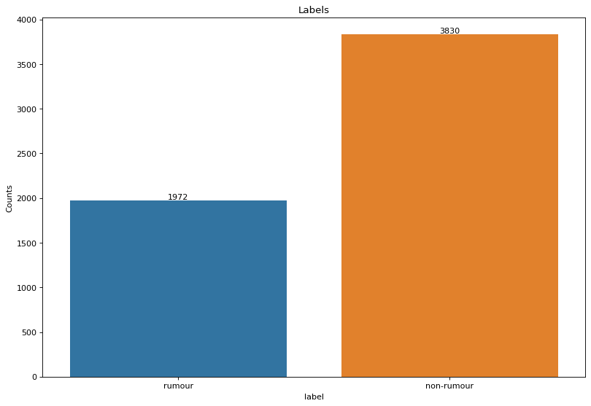
The pheme dataset was processed using the same methodology (preprocessing techniques and models) as the LIAR dataset.
The graph above shows the distribution of the labels in the pheme dataset, while the rumour records in the dataset are 1972, the non-rumor records are 3830 showing that there exists more non-rumor records than rumor records in the dataset.

Slide 35
Results for Feature Extraction with different Models
Model | Train Accuracy | Test Accuracy
Light GBM | 0.9405711345510677 | 0.7315926892950392
Catboost | 0.8862876254180602 | 0.7357702349869452
Random Forest | 0.9992281965526113 | 0.7039164490861619
Naives Bayes | 0.6315924877797787 | 0.6454308093994778
Logistic Regression | 0.7193208129662979 | 0.7060052219321149
The results of the various models on the pheme dataset when applied to the features extracted is presented in the above table. The table shows that the model still overfits to some extent, and that the LightGBM and Catboost models perform the best on the dataset, while Naïve bayes performs the worst.

Slide 36
Results for TF-IDF with different Models
Model | Train Accuracy | Test Accuracy
Light GBM | 0.9318240288139954 | 0.8172323759791122
Catboost | 0.9073835863133523 | 0.8407310704960835
Random Forest | 0.9997427321842037 | 0.8428198433420365
Naives Bayes | 0.9737586827887831 | 0.7368146214099217
Logistic Regression | 0.89452019552354 | 0.829242819843342
The results of the various models on the pheme dataset when the TF_IDF extraction method was applied is shown in the above table. Using this technique, catboost and random forest perform best on the dataset while naïve bayes give the least performance.

Slide 37
F1-Scoring metric
Because the PHEME dataset is unbalanced, an alternative evaluation metric (F1-score)
was implemented on the test dataset to better evaluate model performance.
Model | Feature Extraction | TF-IDF
Light GBM | 0.5506993006993007 | 0.732824427480916
Logistic Regression | 0.46736045411542104 | 0.7304204451772465
Catboost | 0.5399999999999999 | 0.7581284694686756
Naive Bayes | 0.5847094801223242 | 0.664
Random Forest | 0.4346076458752515 | 0.7674597083653109
Based on the F1-score metric, the best performing technique is TF-IDF with Random Forest.

Slide 38
CONCLUSION
The model was trained using Deep learning technique and Five algorithms – LightGBM, Catboost, Naïve Bayes, Logistic Regression and Random Forest - on the LIAR and PHEME dataset for the early detection of misinformation using linguistic analysis and feature extraction.
The LAIR data was trained using labels that were regrouped and the actual labels.
The LAIR data analysis results indicate that the model is overfitting on the training dataset as the max depth of the models increases.
The results also indicates that using the regrouped labels gave better performance than the actual labels.
TF-IDF feature extraction with Random Forest algorithm performs best on the PHEME dataset.

Slide 39
FUTURE WORK
Exploring different algorithms besides the LightGBM and Random Forest might provide a more comparative analysis and training model to improve the model’s performance possibly. Collecting and incorporating additional data could also help improve the generalisability of the model to newer datasets, as the LIAR dataset used in the study may need to be larger to represent all types of misinformation.
Fine-tuning hyperparameters such as learning rate, and depth of trees, the number of trees can significantly impact the model’s performance as well as using a pre-trained model as opposed to one created from scratch on a similar dataset as a starting point can help save time and resources and potentially improve the model’s accuracy.
While the study focused on linguistic analysis and feature extraction, it may be worthwhile to investigate other approaches, such as network or social media analysis, to optimise the model’s performance.

Slide 40
REFERENCES
Agarwala V., Sultana P. H., Malhotra S. & Sarkar A. (2019). Analysis of Classifiers for Fake News Detection. Procedia Computer Science. 165, pp. 377-383.
Ali, M. A. et al. (2022). Deep Ensemble Fake News Detection Model Using Sequential Deep Learning Technique. Sensors, 22(7), 6970.
Divya, T.V. & Banik, G.B. (2021) An Empirical Study on Fake News Detection System using Deep and Machine Learning Ensemble Techniques. International Journal of Advanced Computer Science and Applications, 12.
Khanam, Z., Alwasel, B. N., Sirafi, H., & Rashid, M. (2021). Fake News Detection Using Machine Learning Approaches. ASCI-2020, IOP Conf. Series: Materials Science and Engineering, 1099(1), 012040. doi:10.1088/1757-899X/1099/1/012040
Kudryk, T., & Lindh, A. (2022). Machine learning and neural networks in fake news detection: a mapping study. Degree Project in Technology, Stockholm, Sweden.

Slide 41
REFERENCES (Cont’d)
Mahyoob, M., Algaraady, J., & Alrahaili, M. (2020). Linguistic-based detection of fake news in social media. International Journal of English Linguistics, 11(1), 99. https://doi.org/10.5539/ijel.v11n1p99
Ravish, R., Katarya, R., Dahiya, D., & Checker, S. (2022). Fake news detection system using featured-based optimised MSVM classification. IEEE Access, 10, 113189-113197.
Sousa-Silva, R. (2022). Fighting the fake: A forensic linguistic analysis to fake news detection. International Journal for the Semiotics of Law - Revue Internationale De Sémiotique Juridique, 35(6), 2409–2433. https://doi.org/10.1007/s11196-022-09901-w
Wang, W. Y., Chen, Y. F., & Li, T. (2020). Liar, liar, pants on fire: A new benchmark dataset for fake news detection. Proceedings of the 58th Annual Meeting of the Association for Computational Linguistics, 4222-4228.
Zhou, L., Tao, J., & Zhang, D. (2022). Does fake news in different languages tell the same story? An analysis of multi-level thematic and emotional characteristics of news about COVID-19. Information Systems Frontiers. https://doi.org/10.1007/s10796-022-10329-7

